Slide 1
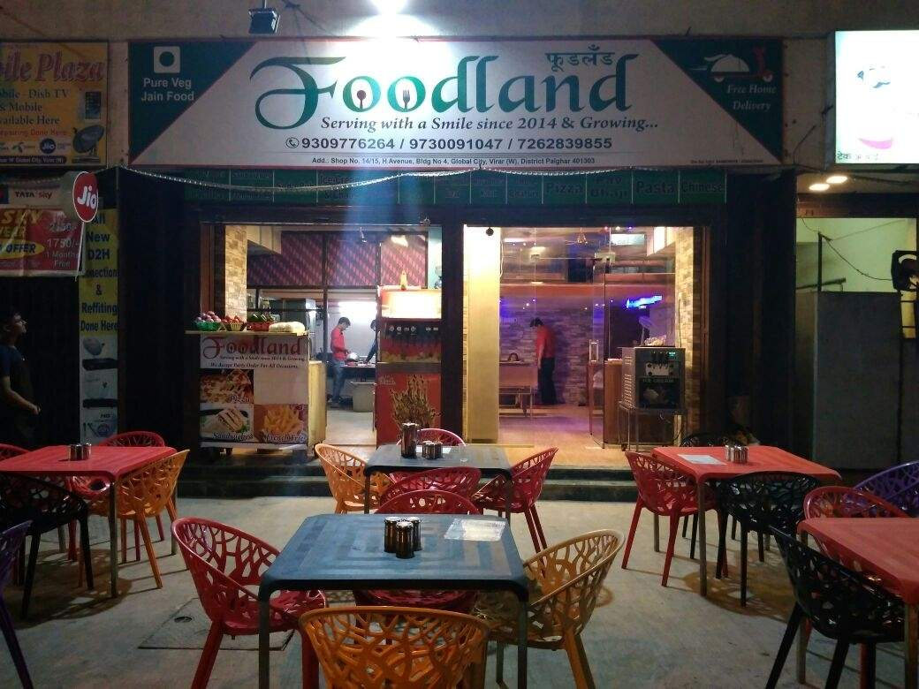
Submitted To Submitted By
Mr. Bose K.Shanmugapriya

Slide 2
Agenda
Client Problem
Month-Wise Report
Sales Analysis of Dishes
Bar Chart
Fish Bone Diagram
Improvement Tips

Slide 3
Client Problem
My client has rent a hotel and named as ‘FOODLAND’ near BTM Layout, Bangalore , not in the main road but as a local shop.
The rent of the shop is 14000 per month. The man took the shop to sell fast food like - Biryani, Maggie, Egg Bhujia, Omlets, Chicken Kabab etc.
In the first 3 months he make a profit of around 100000, with a sales of around 300000.
In the 1st month he was selling veg food also, but he stopped after the 2nd month as it stock was not getting out.
After 4 – 5 months down the line the man is making a huge loss in his investment. He has a due of 2 months to pay the rent.
He is lazy to work hard so, he is thinking to close the shop .

Slide 4
Month-Wise Report
Categories | 1st month | 2nd month | 3rd month | 4th month | 5th month
Investment | 175800 | 121300 | 102900 | 69650 | 49650
Rent | 14000 | 14000 | 14000 | 0 | 0
Wages | 24000 | 24000 | 24000 | 18000 | 18000
Grocery | 90000 | 80000 | 61600 | 50000 | 30000
Water Cans | 3300 | 3300 | 3300 | 1650 | 1650
Utensils+ Tables | 30000 | 0 | 0 | 0 | 0
Decoration | 4500 | 0 | 0 | 0 | 0
Profit /Loss | 50000 | 30000 | 20000 | -20000 | -20000

Slide 5
Sales Analysis of Dishes

Slide 6
Bar chart

Slide 7
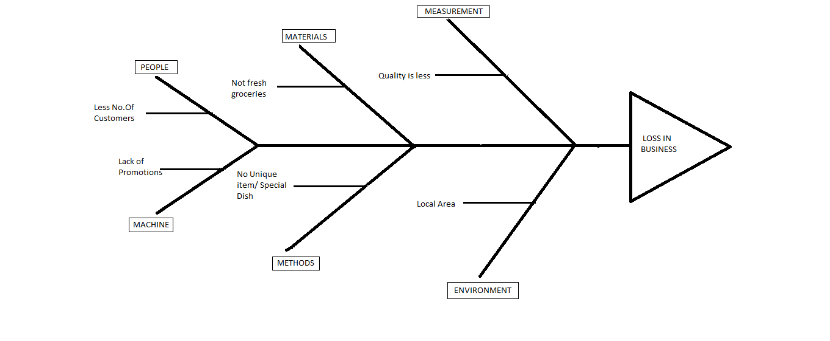
Fish Bone Diagram

Slide 8
Improvement Tips
As the hotel present in local area, it should have some promotions poster.
Be Unique with your special dishes.
Use of fresh and healthy groceries for the cooking.
Attract customer with offers.
Maintain Clean Environment.
Better to install Water Purifier than buying the Water Cans.
He should add veg dish also, so that he will not loss even a single customer.
He should collect feedback from customer.

Slide 9


Slide 10


